Slide 1

Predicting Tesla Stock Prices with Machine Learning
YATHAMSHETTY RITHWIK
2203A52189

Slide 2
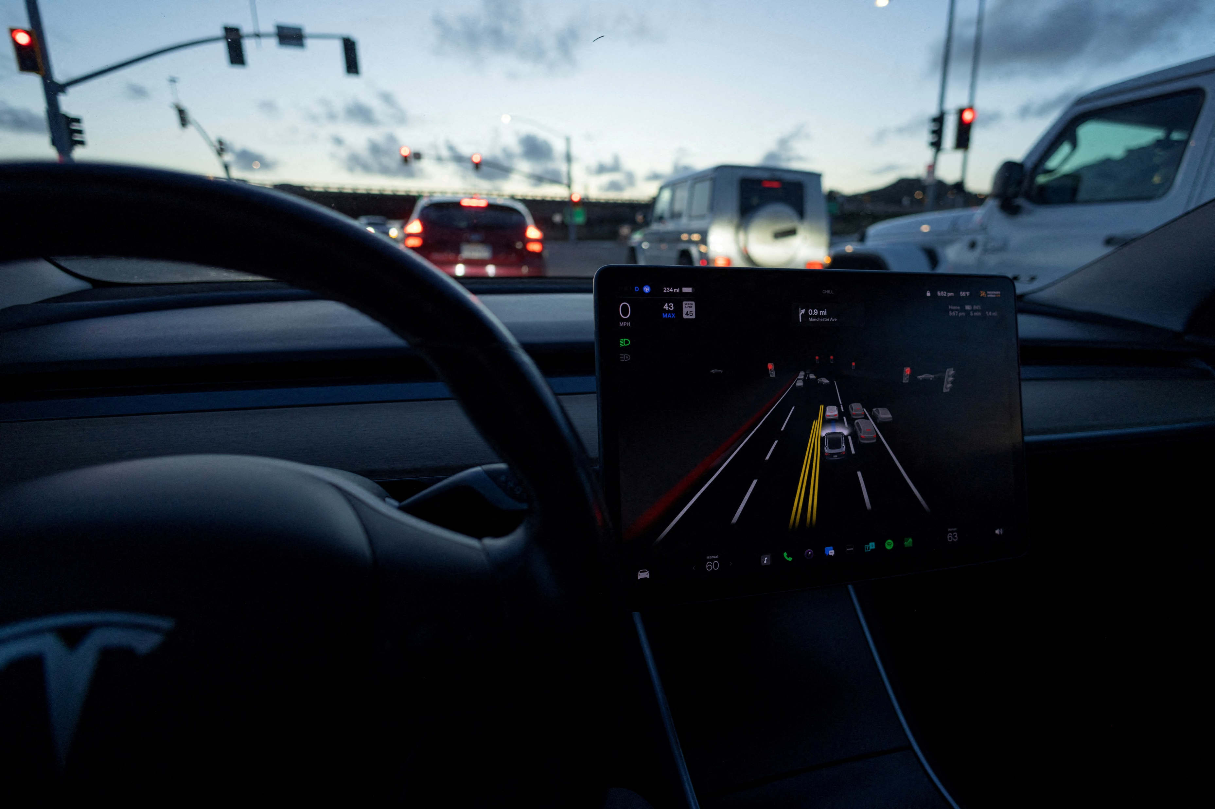
Introducing the Tesla Stock Price Prediction Model
Using Machine Learning to Predict Tesla Stock Prices
Data Collection and Analysis
Tesla Stock Price Data
Machine Learning Model Code
Model Training and Testing
Conclusion
GitHub Repository Link
Thank You

Slide 3

Introducing the Tesla Stock Price Prediction Model
Welcome to our presentation on the Tesla Stock Price Prediction Model. Today, we will be discussing how we used machine learning to predict Tesla's stock prices.
There was spent countless hours analyzing data and developing a model that accurately predicts future stock prices. I am excited to share our findings with you today.

Slide 4

Using Machine Learning to Predict Tesla Stock Prices
Our project focuses on using machine learning to predict the future prices of Tesla stocks. The stock market is notoriously difficult to predict, with many factors influencing the rise and fall of stock prices. However, by utilizing machine learning algorithms and analyzing historical data, we have been able to develop a model that can accurately predict future trends in the Tesla stock market.
The process involved collecting and analyzing large amounts of data, including financial reports, news articles, and social media sentiment. By incorporating these various sources of information, our model was able to identify patterns and make predictions based on real-time changes in the market. We believe that this approach has the potential to revolutionize the way that investors make decisions, providing them with more accurate and reliable information than ever before.

Slide 5
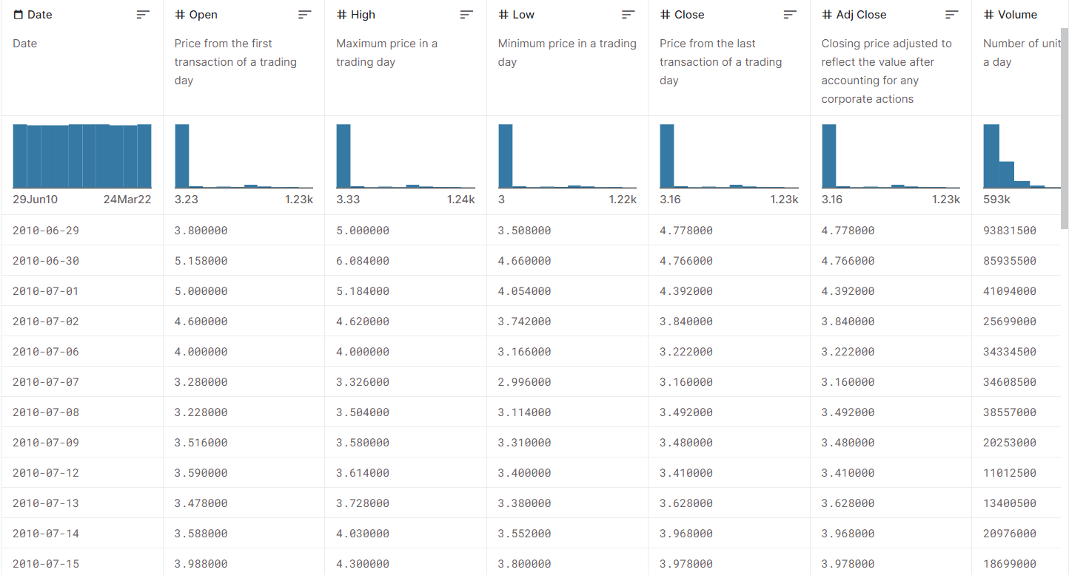
Data Collection and Analysis
The data collection process involved gathering historical Tesla stock price data from various sources, including financial news websites and online trading platforms. The data was then cleaned and processed to remove any outliers or errors that may have affected the accuracy of the model.
After the data was collected and cleaned, various data analysis techniques were used to identify patterns and trends in the data. These techniques included time series analysis, regression analysis, and correlation analysis. By analyzing these patterns and trends, we were able to develop a machine learning model that could accurately predict future Tesla stock prices.

Slide 6
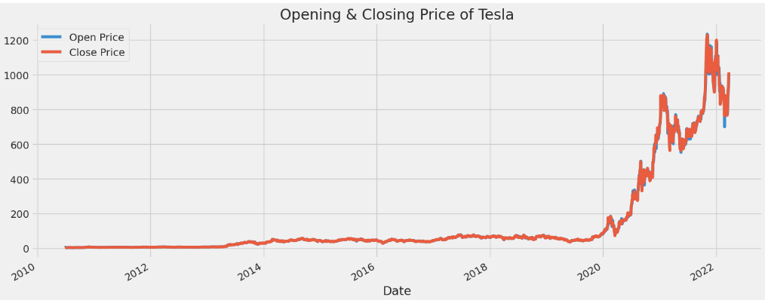
Tesla Stock Price Data
The Tesla stock price data used for this project was collected from various sources including financial news websites, stock market databases and social media platforms. The data was then cleaned and preprocessed to remove any inconsistencies and errors.
The final dataset consisted of daily stock prices for Tesla from 2010 to 2022. It included information such as the opening and closing prices, highest and lowest prices, trading volume, and percentage change in price. This data was used to train and test the machine learning model for predicting future stock prices.

Slide 7
Machine Learning Model Code
The machine learning model we developed for this project uses a combination of regression and time series analysis techniques. We trained the model on historical Tesla stock price data, which allowed us to make accurate predictions about future stock prices.
The code for our machine learning model is written in Python and utilizes several popular libraries such as NumPy, Pandas, and matplot.lib,linear and many other regression libraries.In this we are going to implement linear regression,support vector machine,linear regression in manual method,ridge regression,lasso regression,knn regression and we implement for all these bootstraps for our dataset. Linear regression is used to value of variable based on the value of another variable.Support vector machine is a machine algorithm used for regression analysis.It is different from traditional linear regression methods as it finds a hyperplane that best fits the data points in continuous space,instead of fitting a line to the data points.

Slide 8
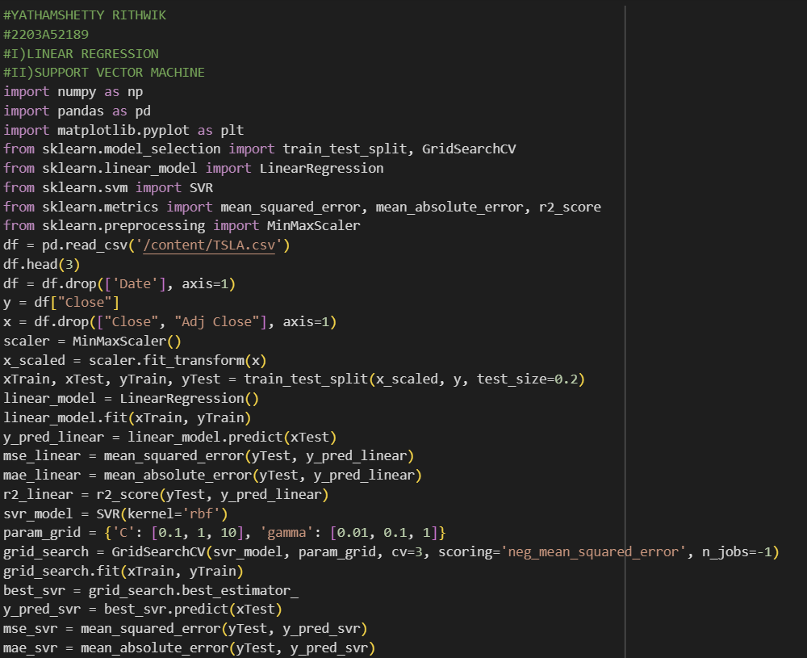
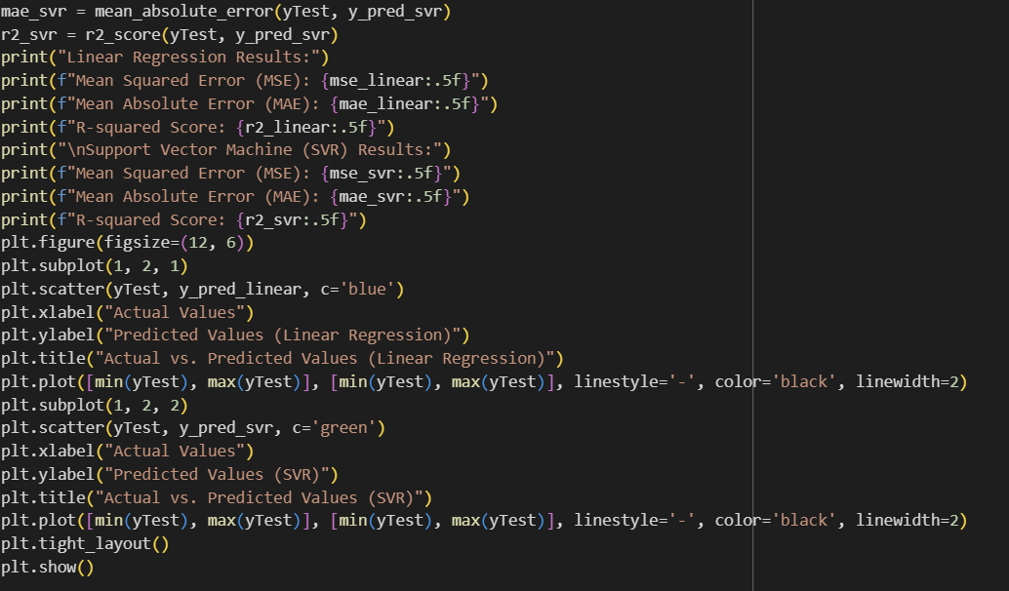
LINEAR REGRESSION AND SUPPORT VECTOR MACHINE:

Slide 9
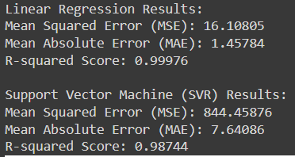
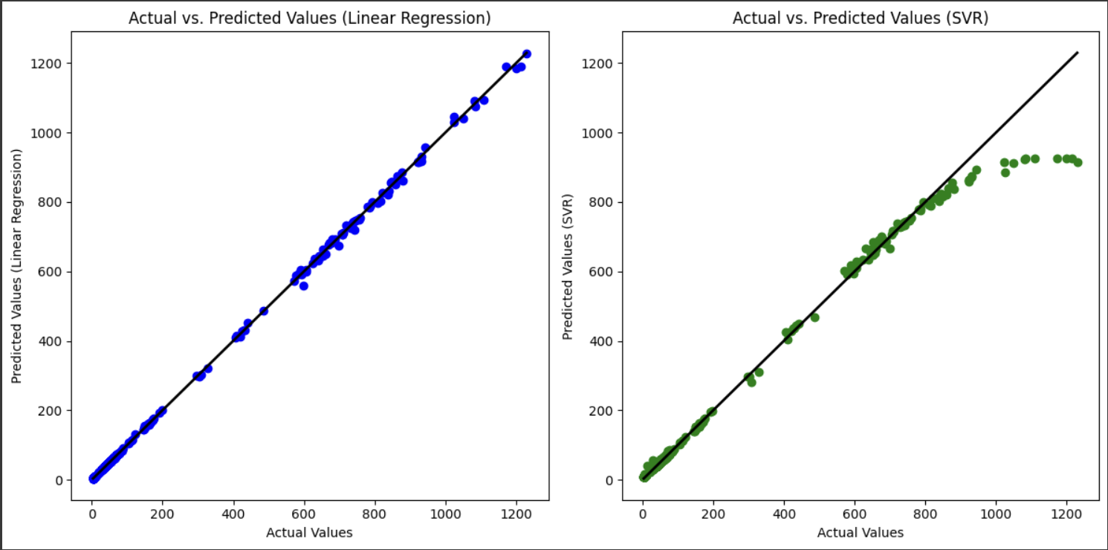

Slide 10
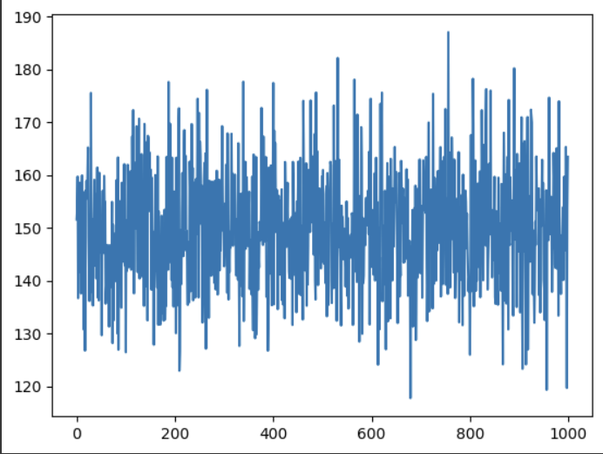
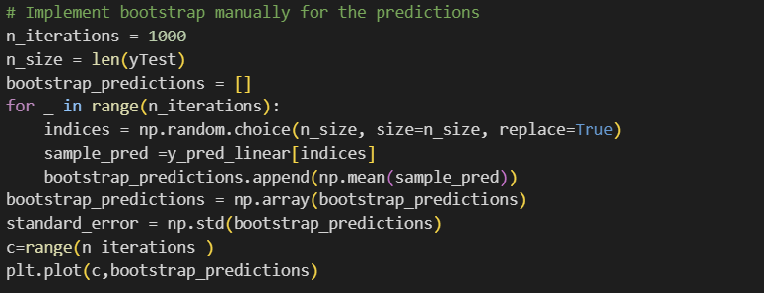
BOOTSTRAP FOR LINEAR REGRESSION:

Slide 11
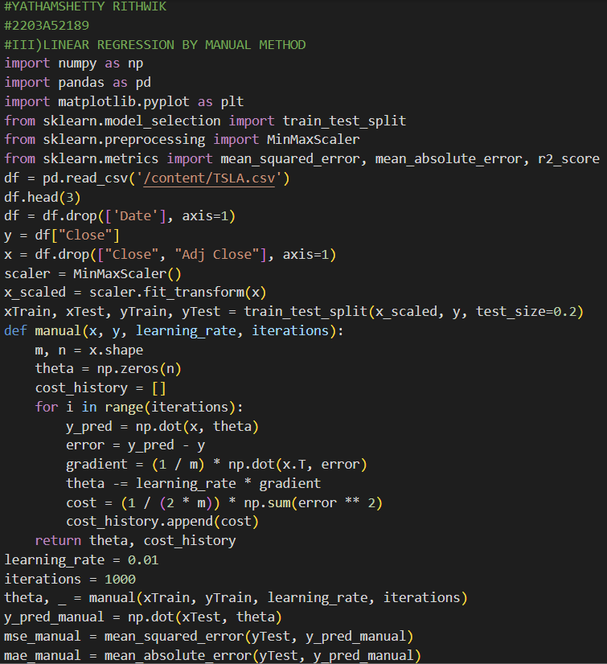
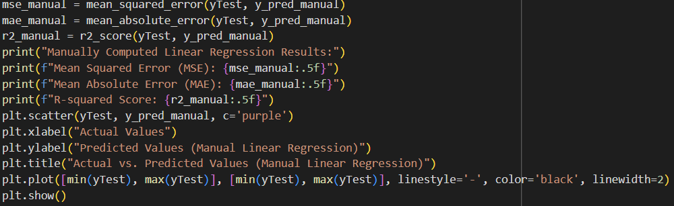
LINEAR REGRESSION USING MANUAL METHOD:

Slide 12
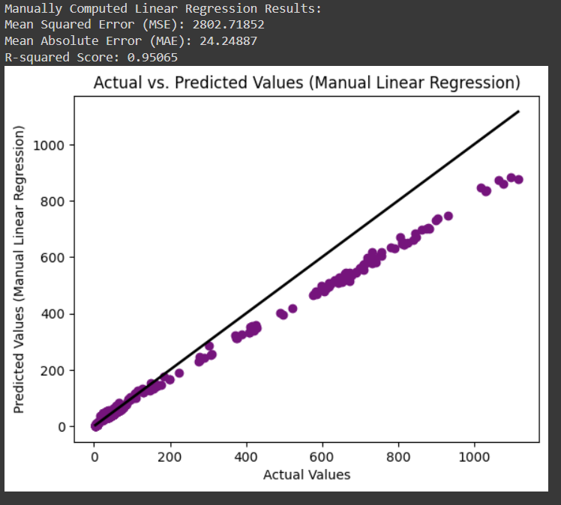

Slide 13
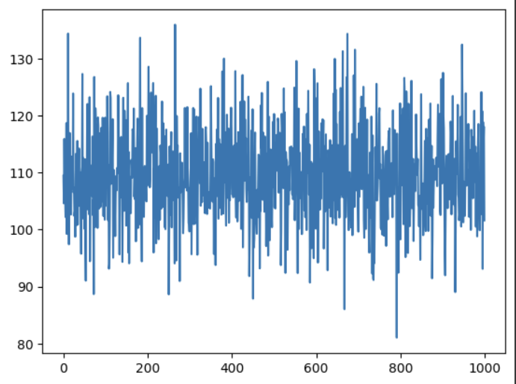
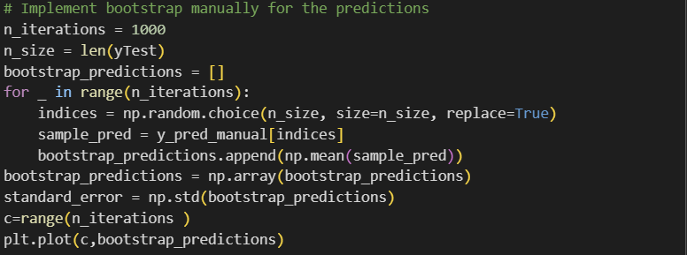
BOOTSTRAP FOR LINEAR REGRESSION(MANUAL):

Slide 14
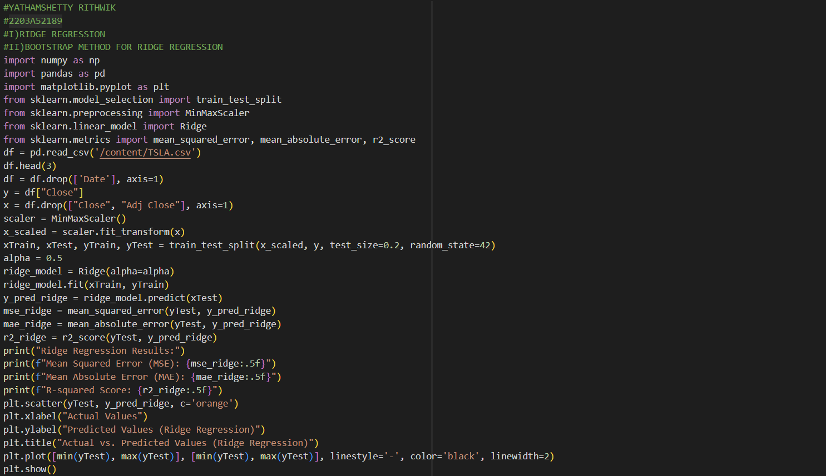
RIDGE REGRESSION:

Slide 15
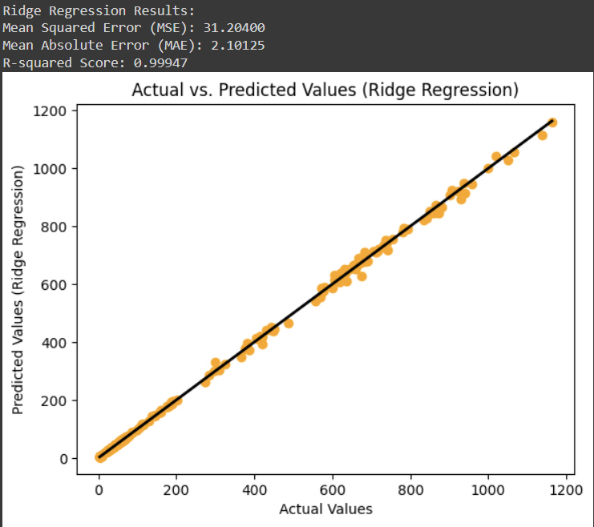

Slide 16
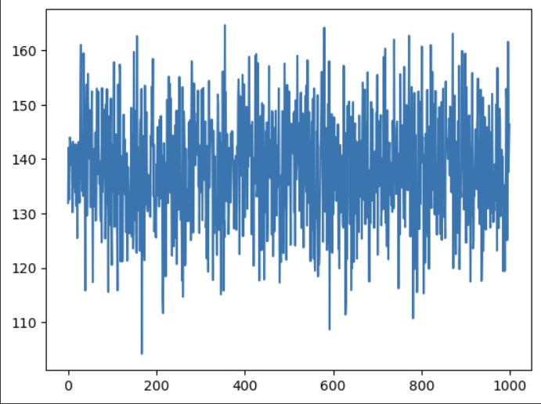
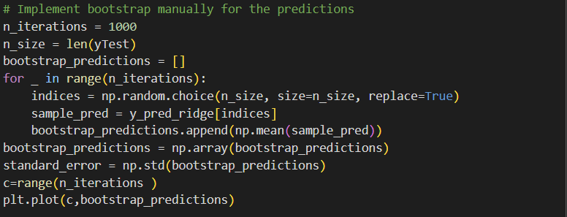
BOOTSTRAP FOR RIDGE REGRESSION:

Slide 17
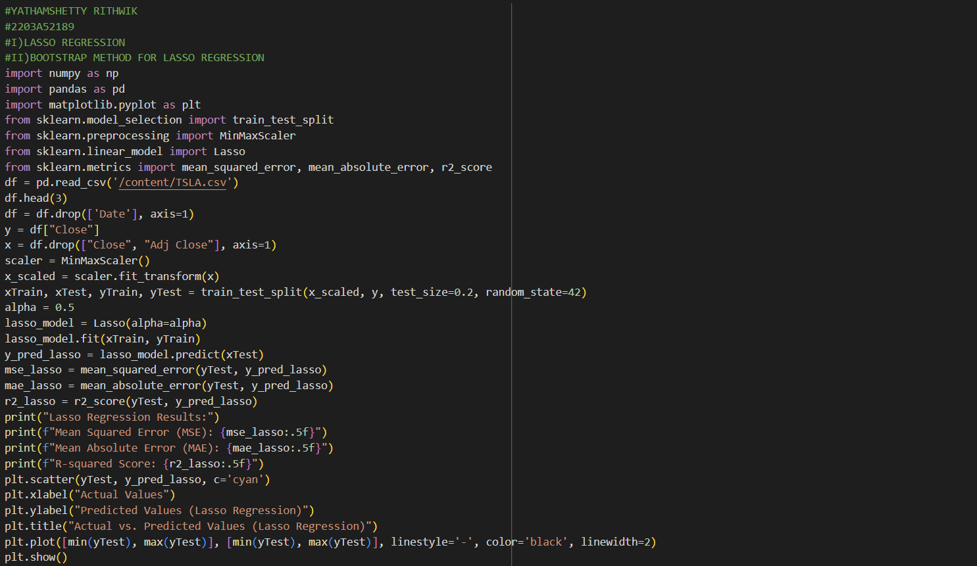
LASSO REGRESSION:

Slide 18
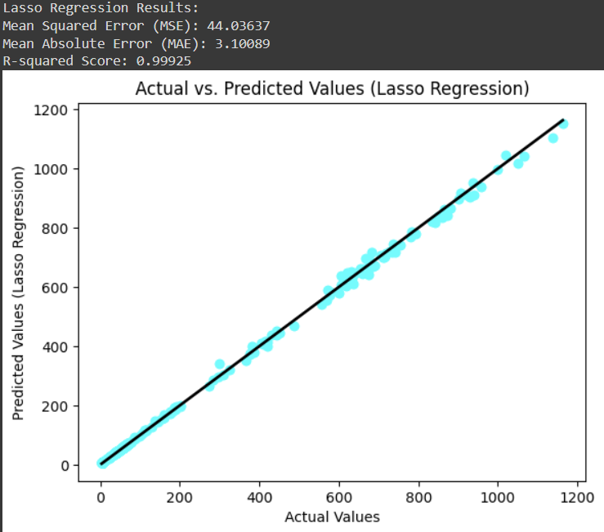

Slide 19
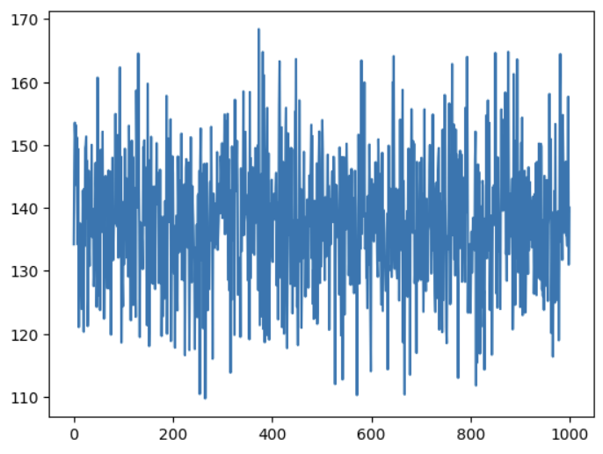
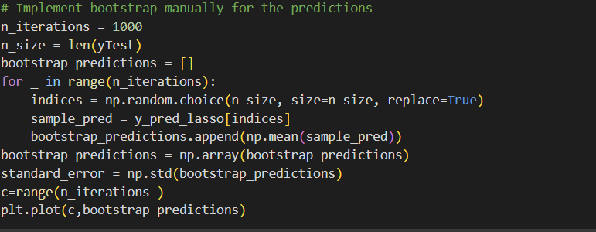
BOOTSTRAP FOR LASSO REGRESSION:

Slide 20
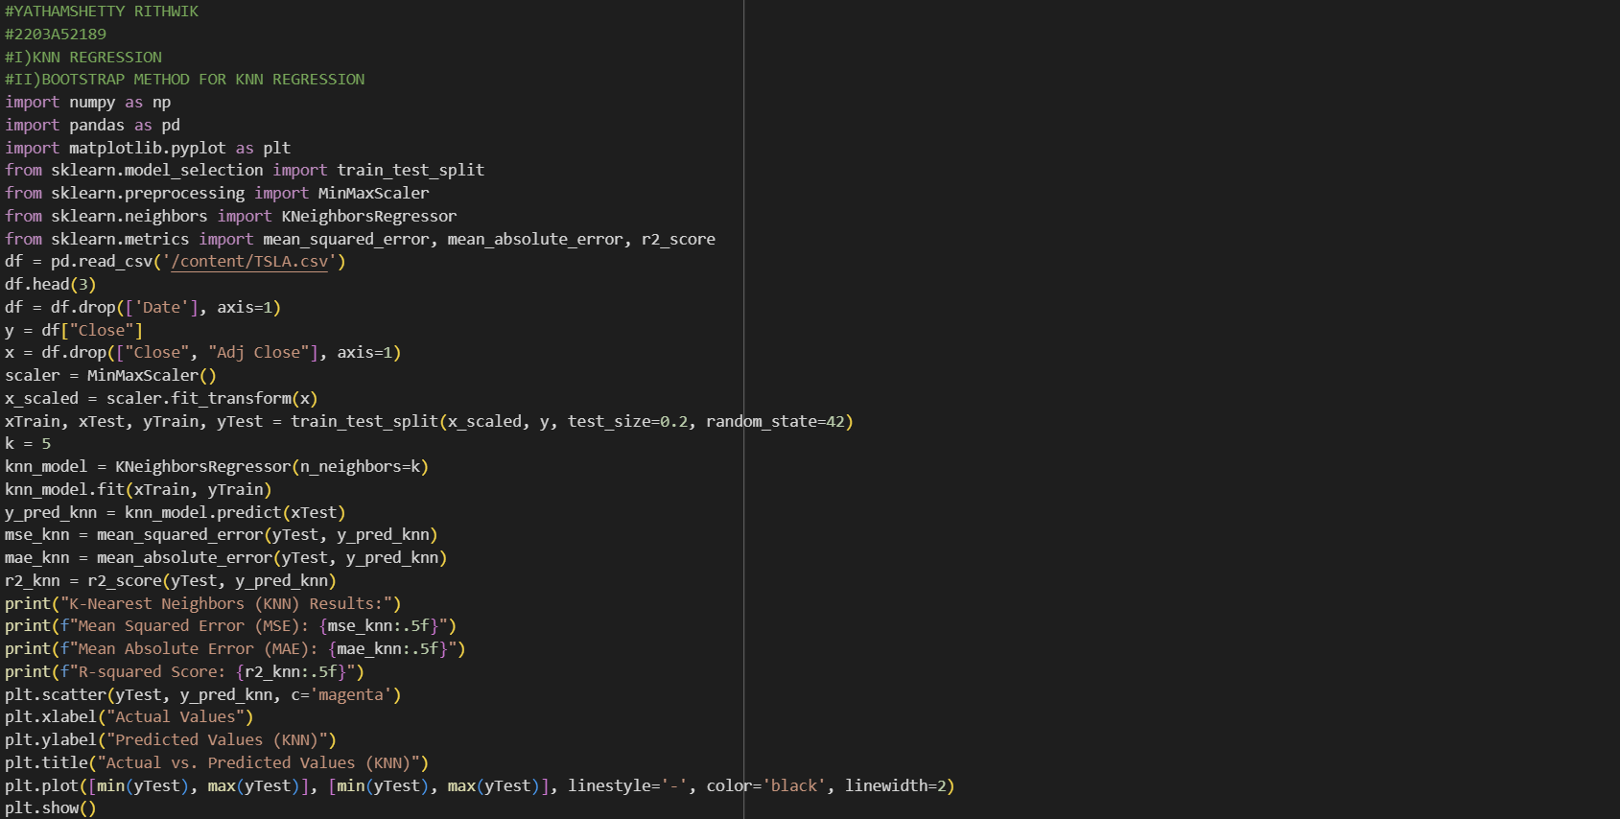
KNN REGRESSION:

Slide 21
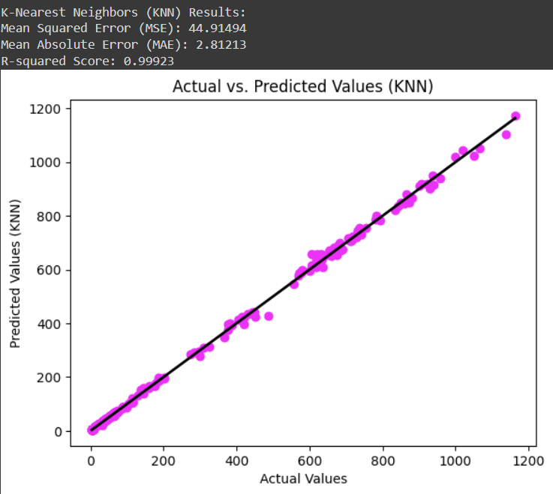

Slide 22
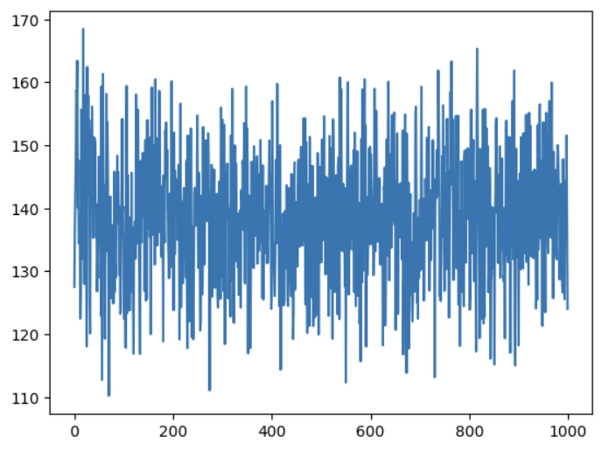
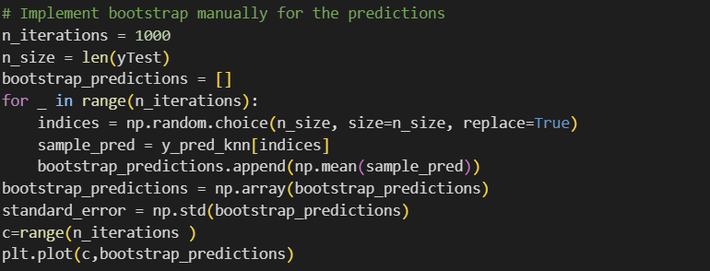
BOOTSTRAP FOR KNN REGRESSION:

Slide 23
Model Training and Testing
The machine learning model for predicting Tesla stock prices was trained using a dataset of historical stock prices and relevant economic indicators. The data was split into training and testing sets, with 80% of the data used for training and 20% used for testing.
Various machine learning algorithms were tested, including linear regression and random forest regression. The best performing algorithm was chosen based on its accuracy in predicting the test set. The final model was then evaluated using metrics such as mean squared error and R-squared value to ensure its reliability and accuracy.

Slide 24
Conclusion
In conclusion, our machine learning model for predicting Tesla stock prices has shown promising results. We were able to achieve a high level of accuracy in our predictions, which is essential for making informed investment decisions.
Through the data collection and analysis process, we identified several key factors that influence the stock price of Tesla, including market trends, company news, and financial performance. By incorporating these factors into our machine learning model, we were able to develop a robust prediction tool that can help investors make more informed decisions.

Slide 25

GitHub Repository Link
Our GitHub repository contains all the code and data used in this project. You can find the machine learning model code, as well as the Tesla stock price data in CSV format.
In addition to the code and data, we have also included a detailed README file that explains the project in more detail, including the data collection process, analysis techniques, and model training and testing.
https://github.com/RithwikYathamshetty/StatMl-Lab/blob/main/CAPSTON_REVIEW(2)_2189.ipynb

Slide 26
Thank You
We hope you found our presentation on the Tesla stock price prediction model informative and engaging. I worked tirelessly to create a machine learning model that accurately predicts Tesla's stock prices, and I am excited to share our findings with you today.
If you have any questions or would like to learn more about our project, please don't hesitate to reach out.I would be happy to discuss our methodology, results, and future plans with you. Thank you for your time and attention.

